Slide 1
Introduction to Modern Software Development
Notes:
This module examines SharePoint Online development strategies and discusses the evolution of modern pages and Microsoft Teams into the SharePoint user experience. Students will learn to program using the Client-side Object Model (CSOM) using C# to automate remote provisioning tasks such as creating SharePoint sites and customized lists. Next, the module provides an overview of Microsoft Azure as a cloud-based development platform and demonstrates how to create essential on-demand services such as Azure Web Apps and Azure SQL databases. The module concludes with a TypeScript primer where students will learn to develop with TypeScript in Visual Studio 2017 to write client-side code using interfaces and strongly-typed programming.

Slide 2
Student Introductions
Basic Info
What’s your name?
Where do you work? (optional)
How long have you been a developer?
List skills with which you already feel comfortable
.NET programming with C# or VB.NET
SharePoint farm solution development
JavaScript and TypeScript
jQuery, React and Angular
Programming with HTTP Requests, REST and OData
Developing with ASP.NET MVC and Web API

Slide 3
Agenda
Understanding SharePoint Development Strategies
Creating a SharePoint Development Environment
Programming the Client-side Object Model (CSOM)
Understanding Azure as a Development Platform
Developing with TypeScript and Interfaces

Slide 4
Evolution of the SharePoint Platform
Farm Solutions
Sandboxed Solutions
SharePoint Add-ins
JavaScript Injection
Remote Provisioning
SharePoint Framework (SPFx)

Slide 5
SharePoint App Add-in Model
SharePoint 2013 introduced new development model
Originally introduced as "SharePoint App” model
Marketing folks renamed "SharePoint App” to "SharePoint Add-in”
Add-in model designed to replace farm solutions
Add-ins designed to supported SPO and SharePoint on-premises
Add-in code not allowed to run on SharePoint host server
Add-in talks to SharePoint using REST and CSOM
Add-in authenticates and establishes add-in identity
Add-in has permissions independent of user
Add-ins deployed to catalogs using publishing scheme

Slide 6
SharePoint APIs
SharePoint REST API
Commonly used with client-side JavaScript code
Good fit when developing SharePoint-hosted add-ins
Accessible to any type of client on any platform
Client-side Object Model (CSOM)
Commonly used with server-side C# code
Good fit when developing provider-hosted add-ins
Good fit when creating desktop clients (e.g. Console app)
Used to perform remote provisioning in SPO sites

Slide 7
JavaScript Injection
JavaScript injection based on central concept…
upload custom JavaScript code to SharePoint Online
execute code using identity and permissions of current user
Approaches for using JavaScript injection
Script Editor Web Part
Adding JavaScript code behind SharePoint site pages
Full-blown Visual Studio project development
Why create solution using JavaScript Injection?
Provides more flexibility than SharePoint add-in model
Poses fewer constraints than SharePoint add-in model

Slide 8
Remote Provisioning
Remote provisioning in SPO
Use CSOM to create SPO site elements
Recommended over SharePoint solutions & features
What can you create with Remote Provisioning
New child sites, lists and document libraries
Site columns, content types and remote event receivers
New pages with custom JavaScript logic
User custom actions with custom JavaScript logic

Slide 9
The SharePoint Framework (SPFx)
Development model based on pages and web parts
Based on client-side development with JavaScript or TypeScript
Code runs with authenticated identity of current user
Easy access to SharePoint and Office 365 content and data
Developer tools designed to support cross-platform development
Great support for targeting mobile devices
SharePoint Page
Client-side Web Part 1
Client-side Web Part 2
TypeScript
TypeScript
Knockout
React
SharePoint REST API
Microsoft Graph API

Slide 10
Agenda
Understanding SharePoint Development Strategies
Creating a SharePoint Development Environment
Programming the Client-side Object Model (CSOM)
Understanding Azure as a Development Platform
Developing with TypeScript and Interfaces

Slide 11
Getting Started with Cloud Development
Create an Office 365 trial tenant for development
In truth, you are really creating an Azure AD tenant
Create global tenant admin user account for developing
Create non-admin user accounts for testing
Create SharePoint Online sites for developing & testing
Obtain a Microsoft Azure subscription
Getting around inside your Azure AD Tenant
Microsoft 365 administrative tools
Azure Portal
SharePoint admin center
PowerShell utilities

Slide 12
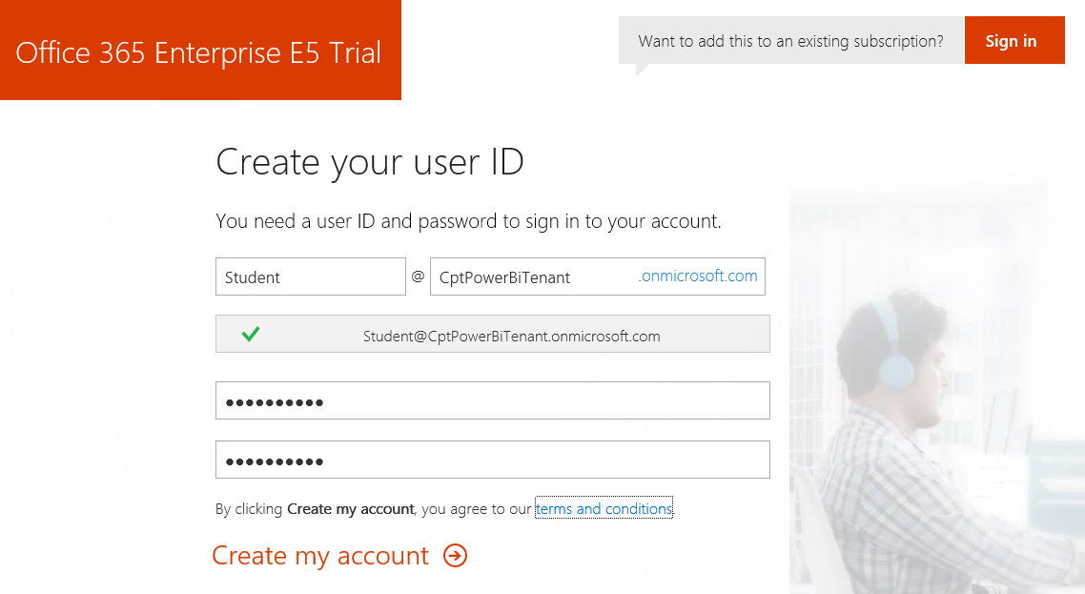
Creating a SharePoint Trial Environment
Sign up for an Office 365 Enterprise E5 trial account
Creates a new Office 365 tenant
Creates an account which is tenant administrator
You can create 25 user accounts for testing purposes
You can create and test Office 365 unified groups
Notes:
In the lab exercises for this course, you will go through the steps to sign up for an Office 365 Enterprise E5 trial account. By doing this you will create a new Office 365 tenant which makes it possible to create multiple user accounts. A key point here is that you are creating a trial account for an entire Office 365 organization as opposed to creating a trial account for a single user.
When you initially create the new Office 365 tenant, you will be prompted to enter the user name and password for a new user account. This initial user account will be created with full tenant administrator capabilities. This means that this accounts with have full administrative control over user management and group management within the Office 365 tenant. This account will also be able to see and modify the organization-wide administrative settings for important cloud services such as Exchange and SharePoint Online.

Slide 13
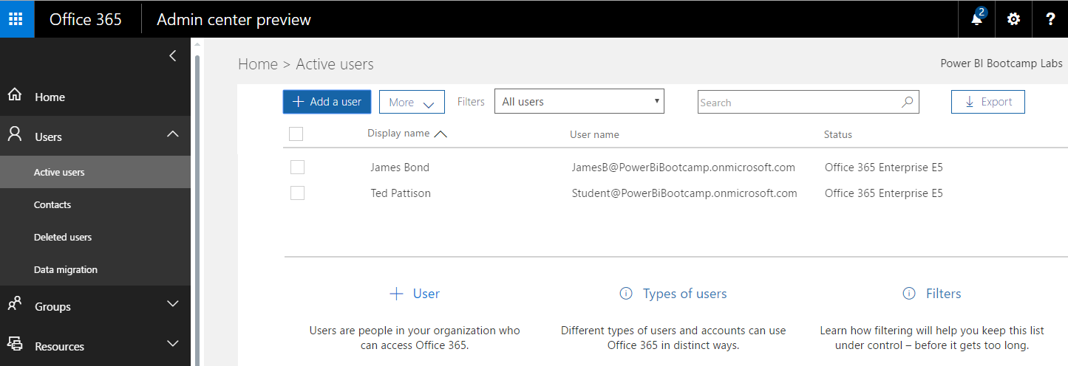
Office 365 admin center
Chores to accomplish in Office 365 admin center
Learn how to add secondary user accounts for testing
Learn how to view and manage groups
Notes:
Once you have created your new Office 365 Enterprise E5 trial account, you should become familiar with the process of navigating around inside the Office 365 admin center. For example, you need to learn how to add new user accounts. You should also learn how to view and create groups in Office 365. That’s because every Power BI group workspace is backed by an underlying Office 365 group. That means that you can use the Office 365 admin center to add and remove users from a Power BI group workspace.

Slide 14
Office 365 Tenancies in SharePoint Online
Office 365 environment based on tenancies
New tenancy is created for each customer organization
Tenancy provides scope for creating users and groups
Tenancy provides scope for creating SharePoint sites
Tenancy provides scope for SharePoint add-ins
Office 365 Developer should be tenant admin
Provides permissions you need to develop and test

Slide 15
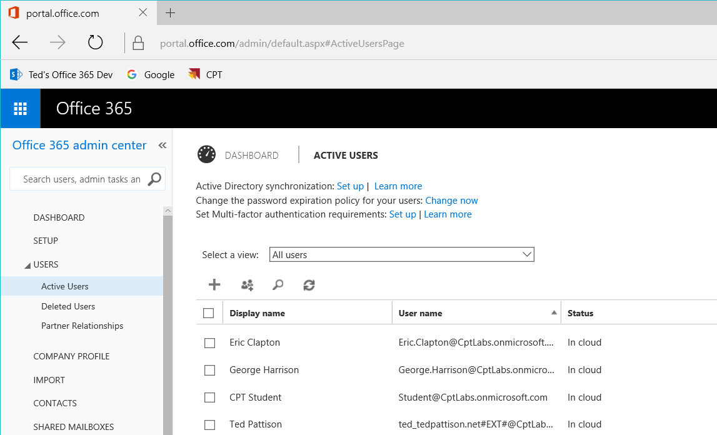
Office 365 admin center

Slide 16
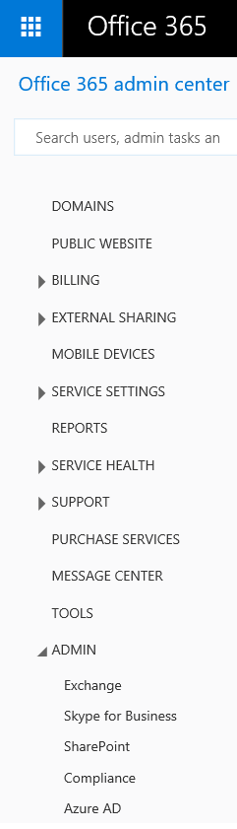
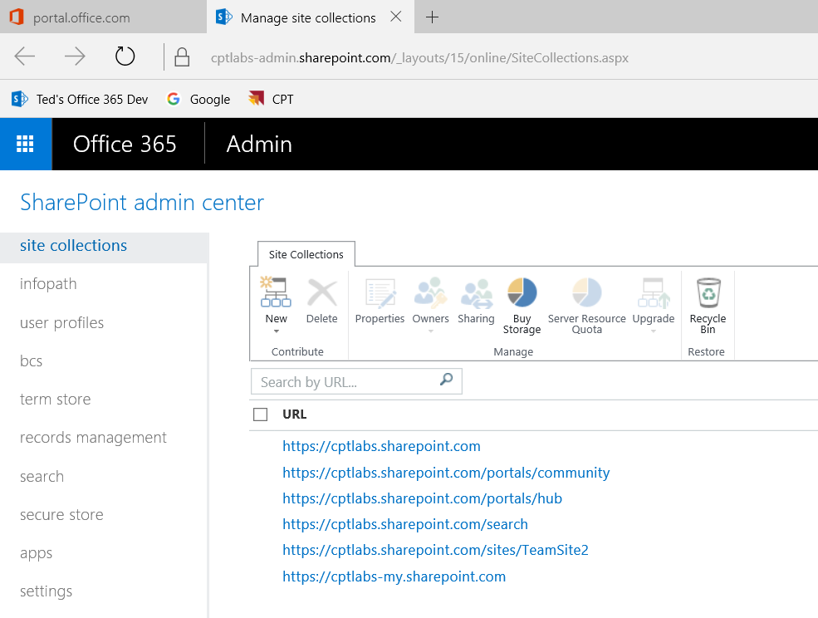
SharePoint admin center

Slide 17
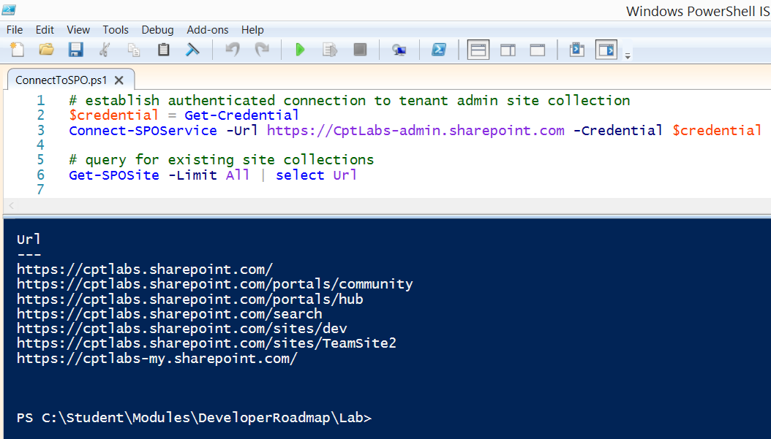
SharePoint Online Management Shell

Slide 18
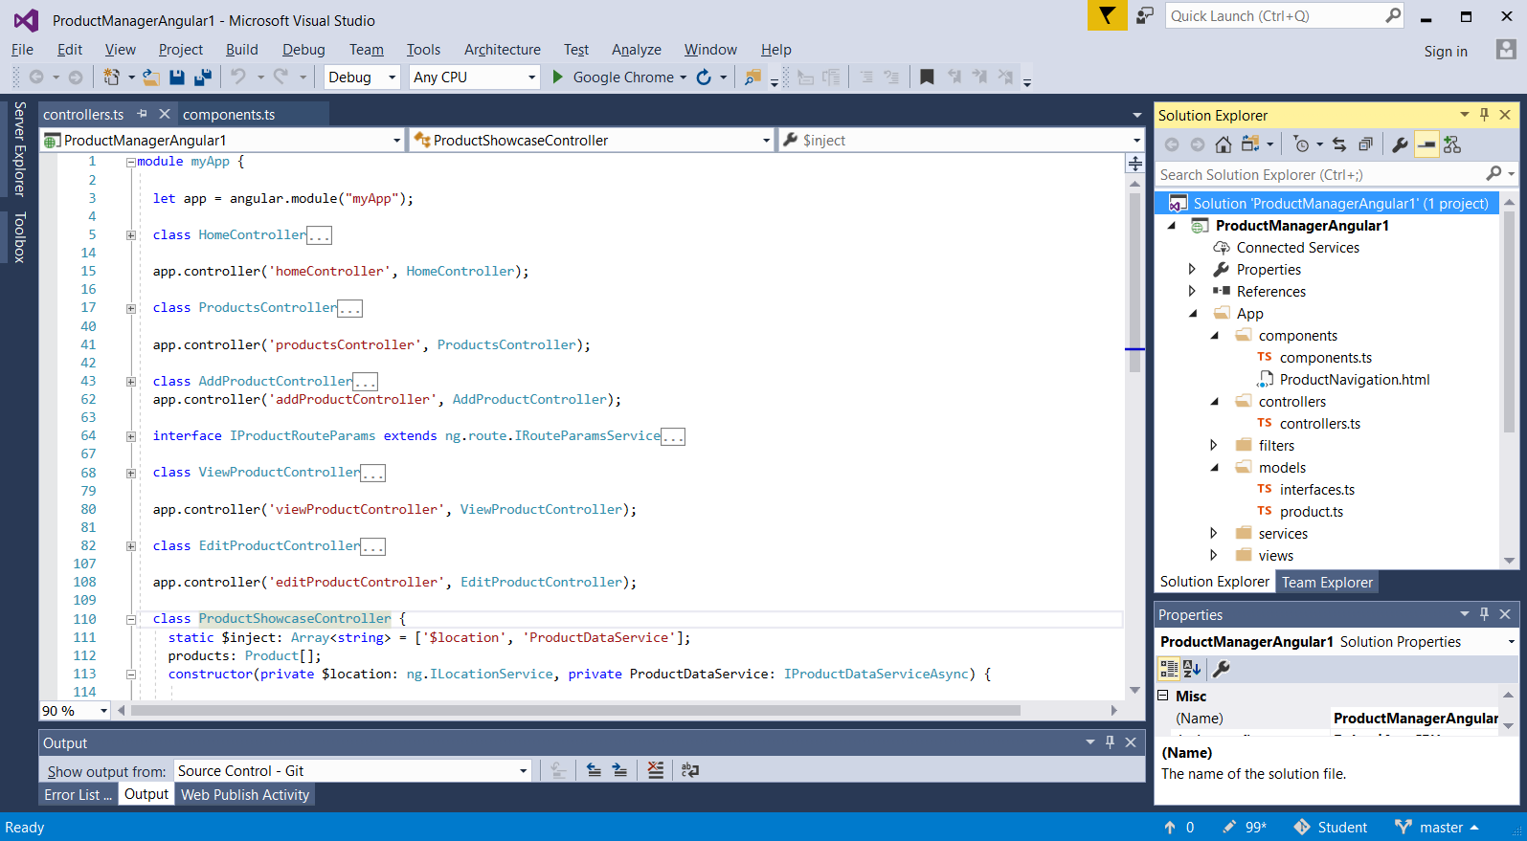
Developing with Visual Studio 2017

Slide 19
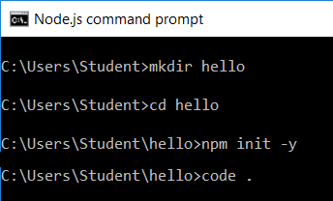
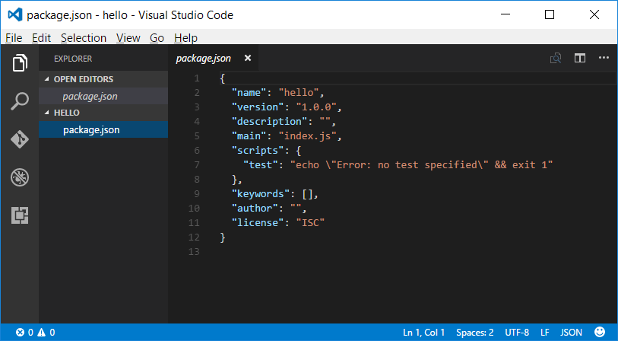
Developing with NPM & Visual Studio Code

Slide 20
Agenda
Understanding SharePoint Development Strategies
Creating a SharePoint Development Environment
Programming the Client-side Object Model (CSOM)
Understanding Azure as a Development Platform
Developing with TypeScript and Interfaces

Slide 21
Why Client Object Model (CSOM)?
Advantages of CSOM over the REST API
Strongly-typed programming
Format Digest managed automatically
Higher productivity when writing C# or VB
Provides ability to batch requests to web server
CSOM provides functionality beyond REST APIs
CSOM more preferable on server-side C#
CSOM isn't best fit for JavaScript apps

Slide 22
Supported CSOM Functionality
What can you do with CSOM?
Work within a specific site collection
Read and modify site properties
Create site columns and content types
Create lists, items, views and list types
Register remote event handlers
Create folder and upload and download files
Add web part and web part pages
Create new site collections

Slide 23
CSOM in SharePoint Online
CSOM Assemblies for SharePoint Foundation
Version 15 intended for SharePoint 2013 On-premises
Version 16.0 intended for SharePoint 2016 On-premises
Version 16.1 (or greater) intended for SharePoint Online
CSOM Assemblies for SharePoint Server

Slide 24
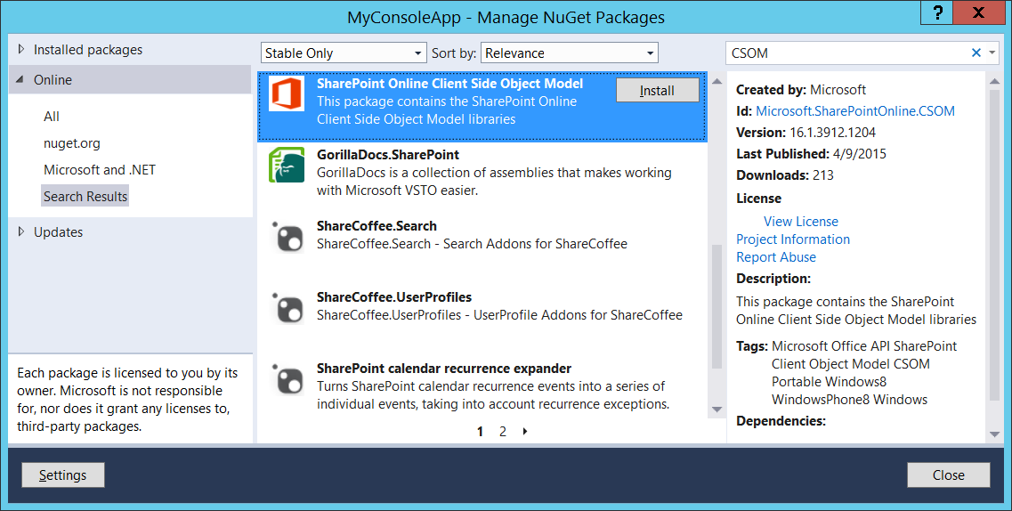
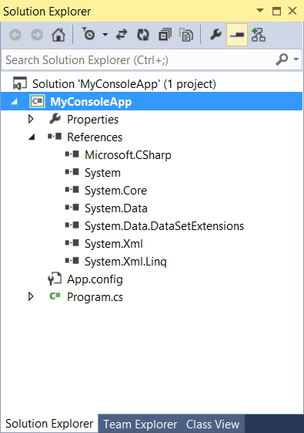
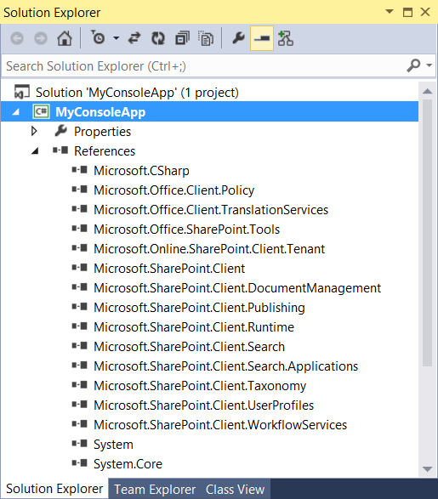
SPO CSOM NuGet Package

Slide 25
CSOM Architecture
CSOM Objects act as client-side proxies
CSOM uses Windows Communication Foundation (WCF)
CSOM Runtime layer handles WCF calls behind scenes
Request body contains XML document of instructions
Response returned in JavaScript Object Nation (JSON)

Slide 26
ClientContext
CSOM coding starts with ClientContext
Provides connection to SharePoint site
Provides access to site and site collection
Provides authentication behavior
Provides ExecuteQuery method to call server

Slide 27
Hello CSOM

Slide 28
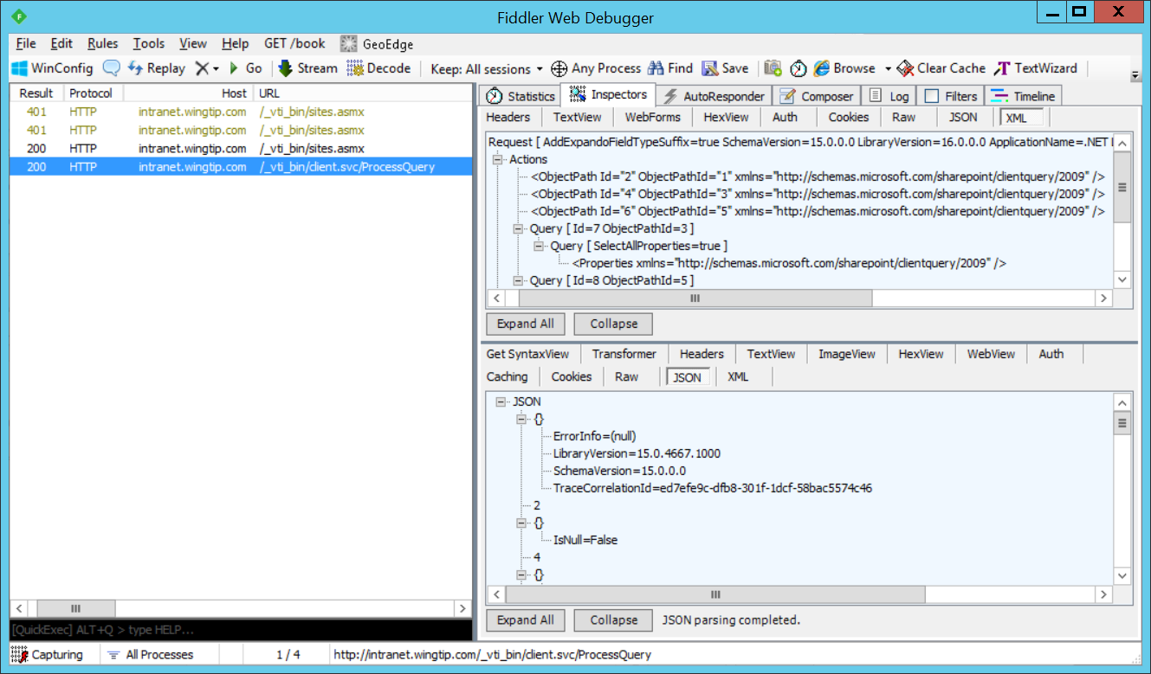
Inspecting CSOM Calls with Fiddler
ExecuteQuery triggers call to SharePoint web server
CSOM calls made behind the scenes using WCF
CSOM calls target /_vti_bin/client.svc/ProcessQuery
Can be helpful to inspect CSOM calls using Fiddler Web Debugger

Slide 29
User Authentication (On-premises)

Slide 30
Coding with Lambda Expressions
C# supports the use of lambda expressions
Syntax Introduced as part of LINQ with .NET 3.5
Can (and should) be used with CSOM
Lambda expression is anonymous function
It defines a parameter list and a function body
Input Parameter(s)
Lambda Operator
Statement Block

Slide 31

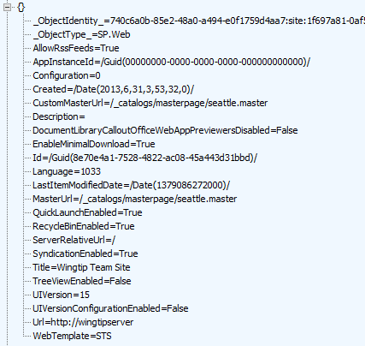

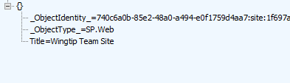
Using Lambda Expressions
Loading an object populates all scalar property values
Can result in inefficient use of network bandwidth
Lambda expressions can be used to optimize
You can indicate which properties you want populated

Slide 32
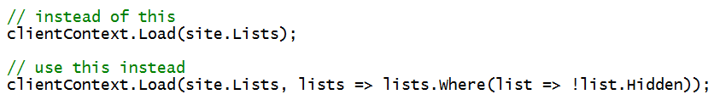
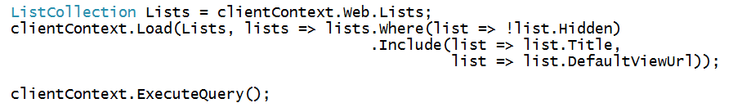
Using Where() and Include()
Where lets you pass filter criteria to server
Include lets you pick fields on item in a collection
Syntax is powerful but tricky to read and write

Slide 33
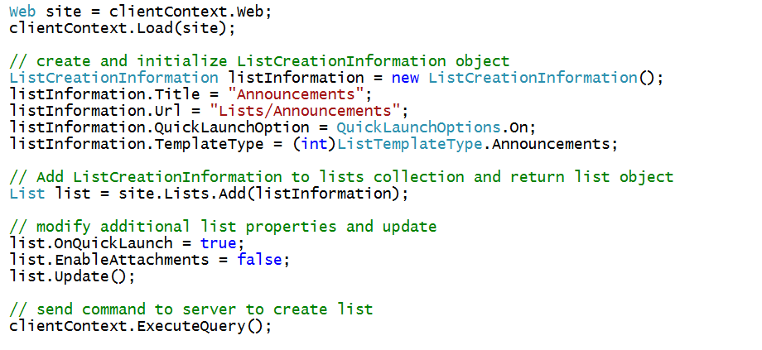
Creating a List

Slide 34
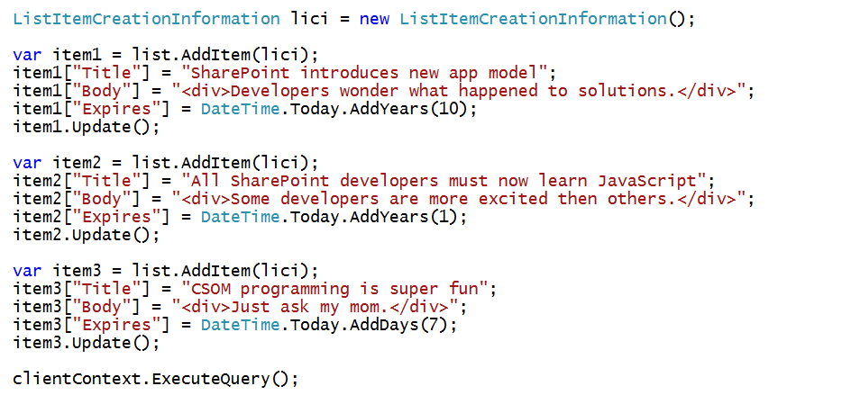
Creating List Items

Slide 35
Creating Site Columns - Part 1

Slide 36
Creating Site Columns - Part 2

Slide 37
Creating Content Types - Part 1

Slide 38
Creating Content Types - Part 2

Slide 39
Creating List with Content Type

Slide 40
Agenda
Understanding SharePoint Development Strategies
Creating a SharePoint Development Environment
Programming the Client-side Object Model (CSOM)
Understanding Azure as a Development Platform
Developing with TypeScript and Interfaces

Slide 41
Cloud Computing Service Models
SaaS – Software as a service
Examples include Salesforce and Office 365
PaaS – Platform as a service
Examples include Azure Web Apps
DaaS – Database as a service
Examples include Azure SQL databases
IaaS – Infrastructure as a service
Examples include Azure VMs and cloud services

Slide 42
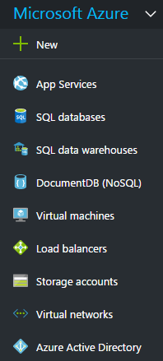
Azure Services Overview
Azure provides PaaS, DaaS and IaaS Services
App Service Plans and Web Apps
SQL databases
Virtual machines
Storage accounts
Virtual networks
Load balancers
Cloud Services
Azure Active Directory
Azure Functions
Notes:
20532C
1: Overview of the Microsoft Azure Platform

Slide 43
Obtaining an Azure Subscription
Getting an Azure Subscription
Sign up with paid-for account
Get free Azure subscription with a MSDN Subscription
Sign up for free 30-day trial account
Signing up for free trial account
Navigate to Azure Portal using Office 365 credentials
When prompted, sign up for a trial

Slide 44
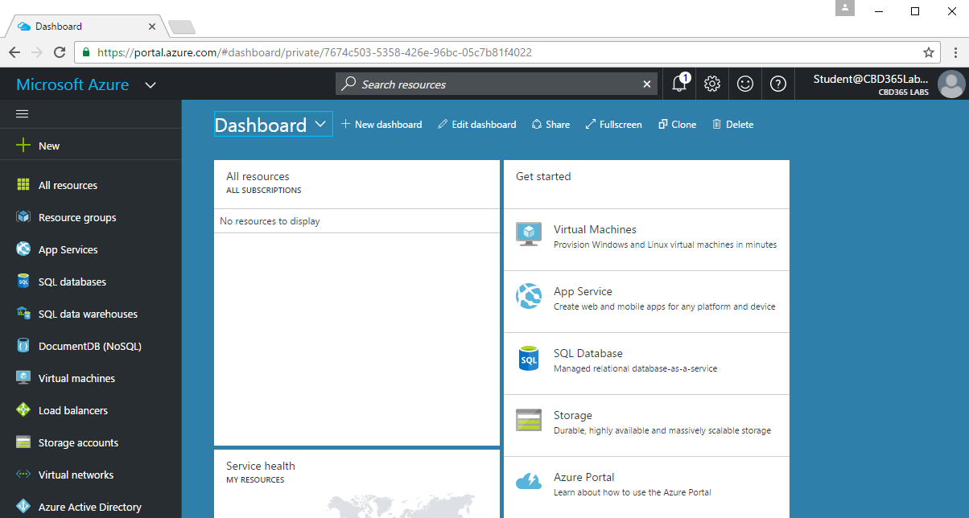
Azure Portal
You can work with Azure using the new portal
Uses newer Resource Manager infrastructure
Located at https://portal.azure.com
Notes:
20532C
1: Overview of the Microsoft Azure Platform

Slide 45
Agenda
Understanding SharePoint Development Strategies
Creating a SharePoint Development Environment
Programming the Client-side Object Model (CSOM)
Understanding Azure as a Development Platform
Developing with TypeScript and Interfaces

Slide 46
What is TypeScript?
A programming language which compiles into plain JavaScript
A superset of JavaScript that adds a strongly-typed dimension
It can be compiled into ECMAScript3, ECMAScript3 or ECMAScript 6
It runs in any browser, in any host and on any OS
product.ts
product.js
TypeScript
Compiler
Notes:
There is a getting started tutorial at https://www.typescriptlang.org/docs/tutorial.html .

Slide 47
Type Annotation
TypeScript allows you to annotate types
Provides basis for strongly-typed programming
Type annotations used by compiler for type checking
Type annotations are erased at the end of compile time

Slide 48
Assignment with let versus var
var does not recognize nor honor scope
let will recognize and honor scope

Slide 49
Arrow Function Syntax
TypeScript supports arrow function syntax
Concise syntax to define anonymous functions
Can be used to retain this pointer in classes

Slide 50
Classes
TypeScript supports defining classes
Class defines type for object
Export keyword makes class created across files
Class can be passed as factory function
Default accessibility is public

Slide 51
Class Constructors
Constructor parameters become fields in class
Client-side code calls constructor using new operator

Slide 52
Interfaces
Interface defines a programming contract
Classes can implement interfaces
Client code can be decoupled from concrete classes

Slide 53
TypeScript Definition Files (d.ts)
What are TypeScript definition files
Typed definitions for 3rd party JavaScript libraries
DefinitelyTyped provides great community resource
Typed definition files have a d.ts extension

Slide 54

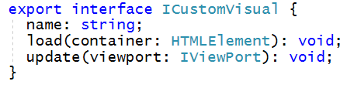
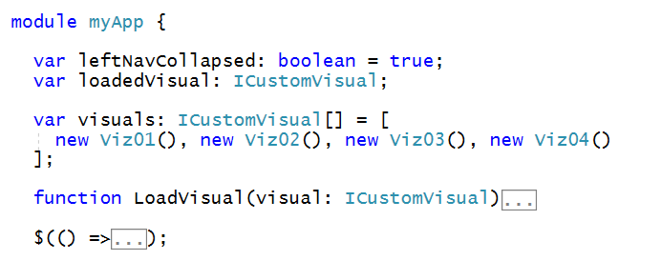
Interface-based Design
Interfaces define programming contracts
Application design can use interfaces instead of concrete classes

Slide 55
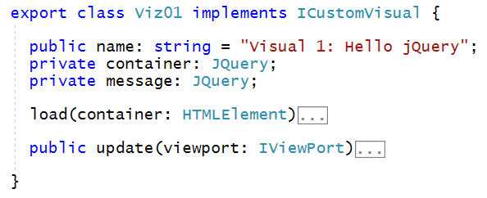
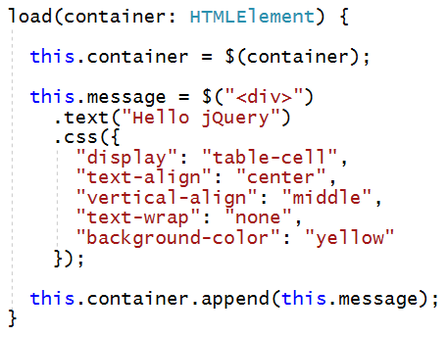
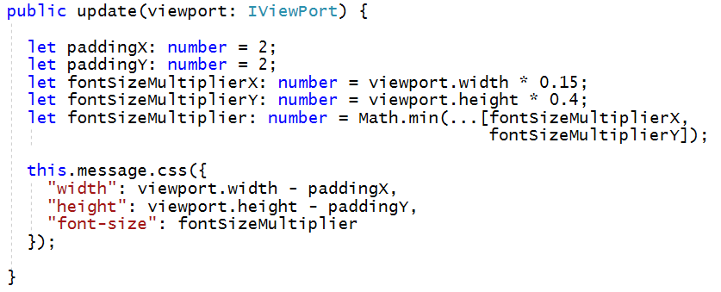
Sample Custom Visual using jQuery

Slide 56
Summary
Understanding SharePoint Development Strategies
Creating a SharePoint Development Environment
Programming the Client-side Object Model (CSOM)
Understanding Azure as a Development Platform
Developing with TypeScript and Interfaces

